Slide 1


Introduction to Python – Week 7
Mark Smith

Slide 2
Course outline
Lesson 1 – Getting Started: Introduction and Arithmetic Operators
Lesson 2 – Types and Variables
Lesson 3 – Functions
Lesson 4 – Conditional Statements
Lesson 5 – Further Conditionals and Recursion
Lesson 6 – Functions with Return Values
Lesson 7 – Loops, Lists and Turtles
Lesson 8 – Dictionaries
Lesson 9 – Tuples
Lesson 10 – Project

Slide 3
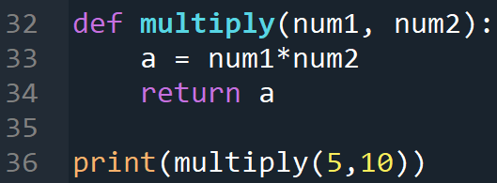
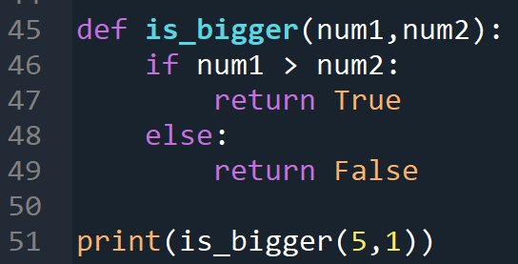
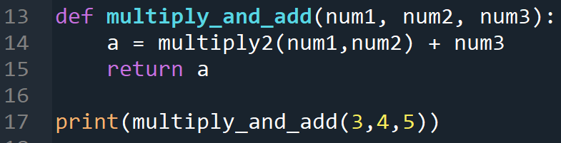
Last Week
What are functions with return values?
Why do we use functions with return values?
What are Boolean functions?

Slide 4
This Week – Loops, Lists and Turtles
Today we will learn:
What are loops?
What are lists?
What is Turtles?

Slide 5
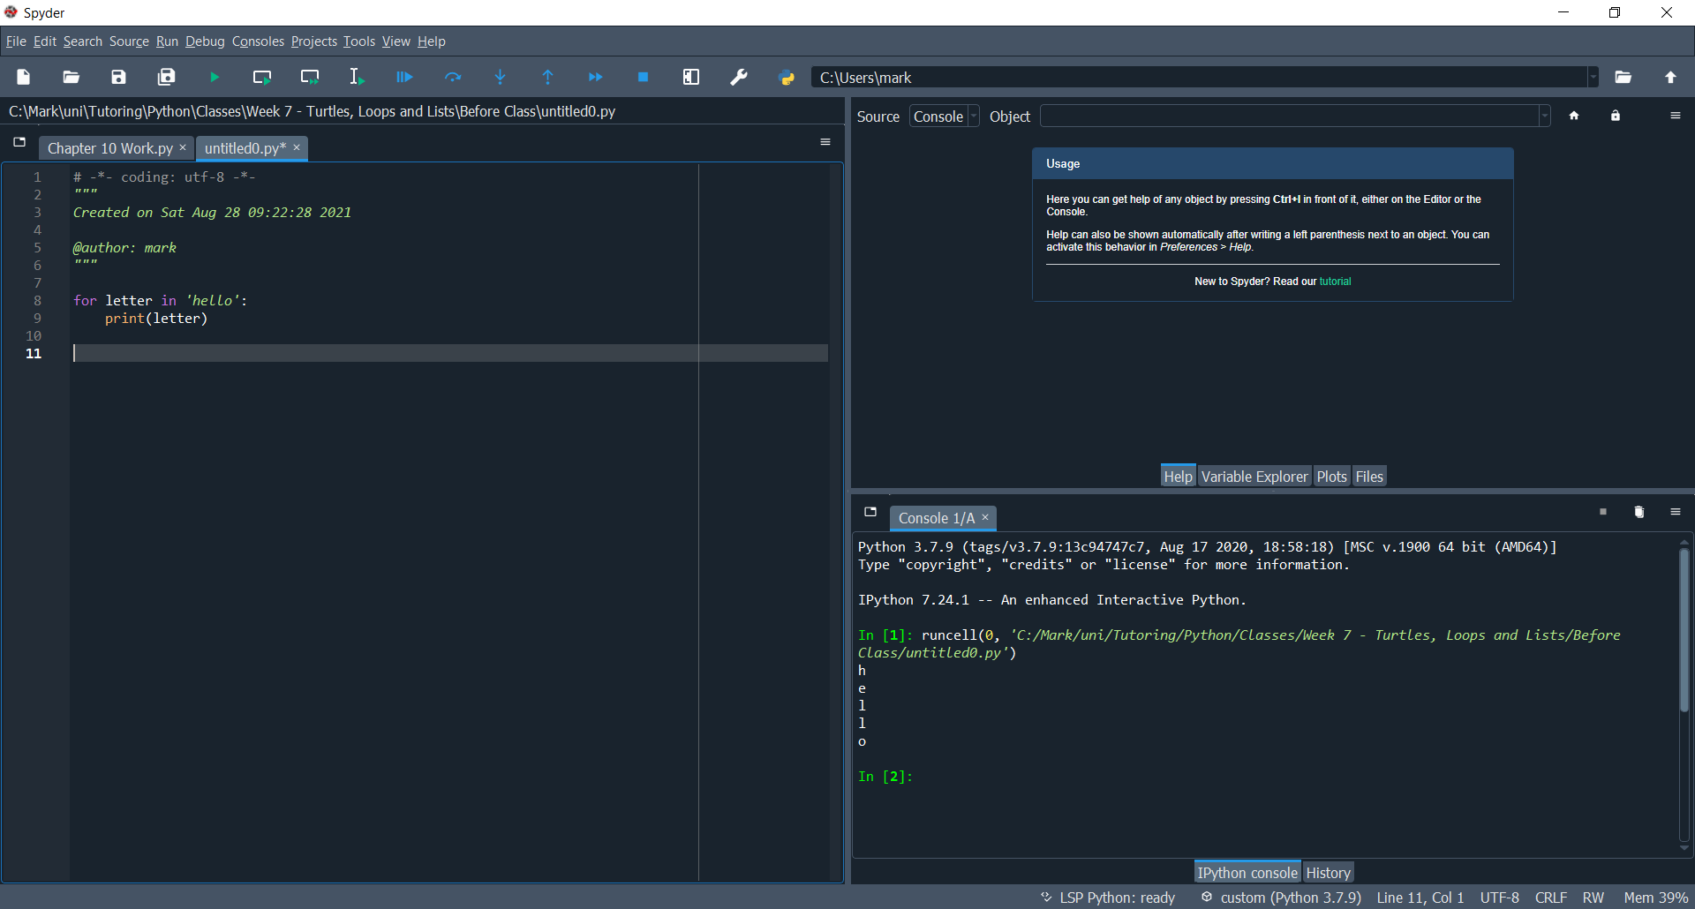
Loops - for
The first loop we will see is a for loop, we can use this to access characters in a string
Note that the syntax is the same as function definitions and conditionals, this time using the keyword.
However, we also need the keyword.

Slide 6
Loops - for
The first loop we will see is a for loop, we can use this to access characters in a string

Slide 7
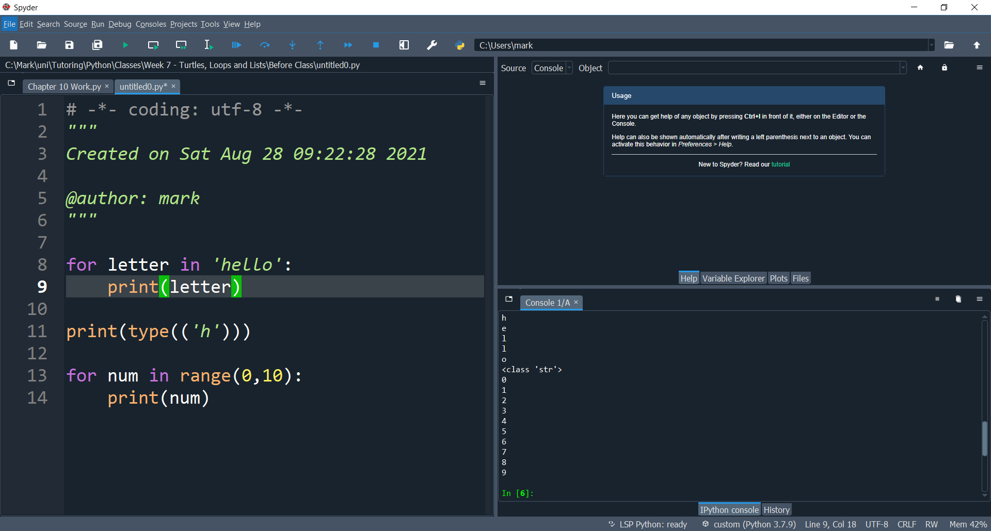
Loops - for
We can also use for loops to access numbers in a range

Slide 8
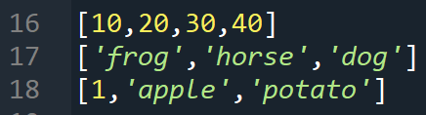
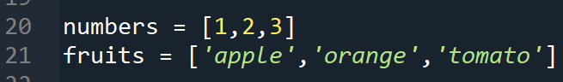
lists
A list is a built in type in Python, like integer or string. A list is a sequence of values
The values inside the list are called elements.
We can assign lists to variables.

Slide 9
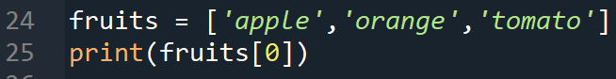
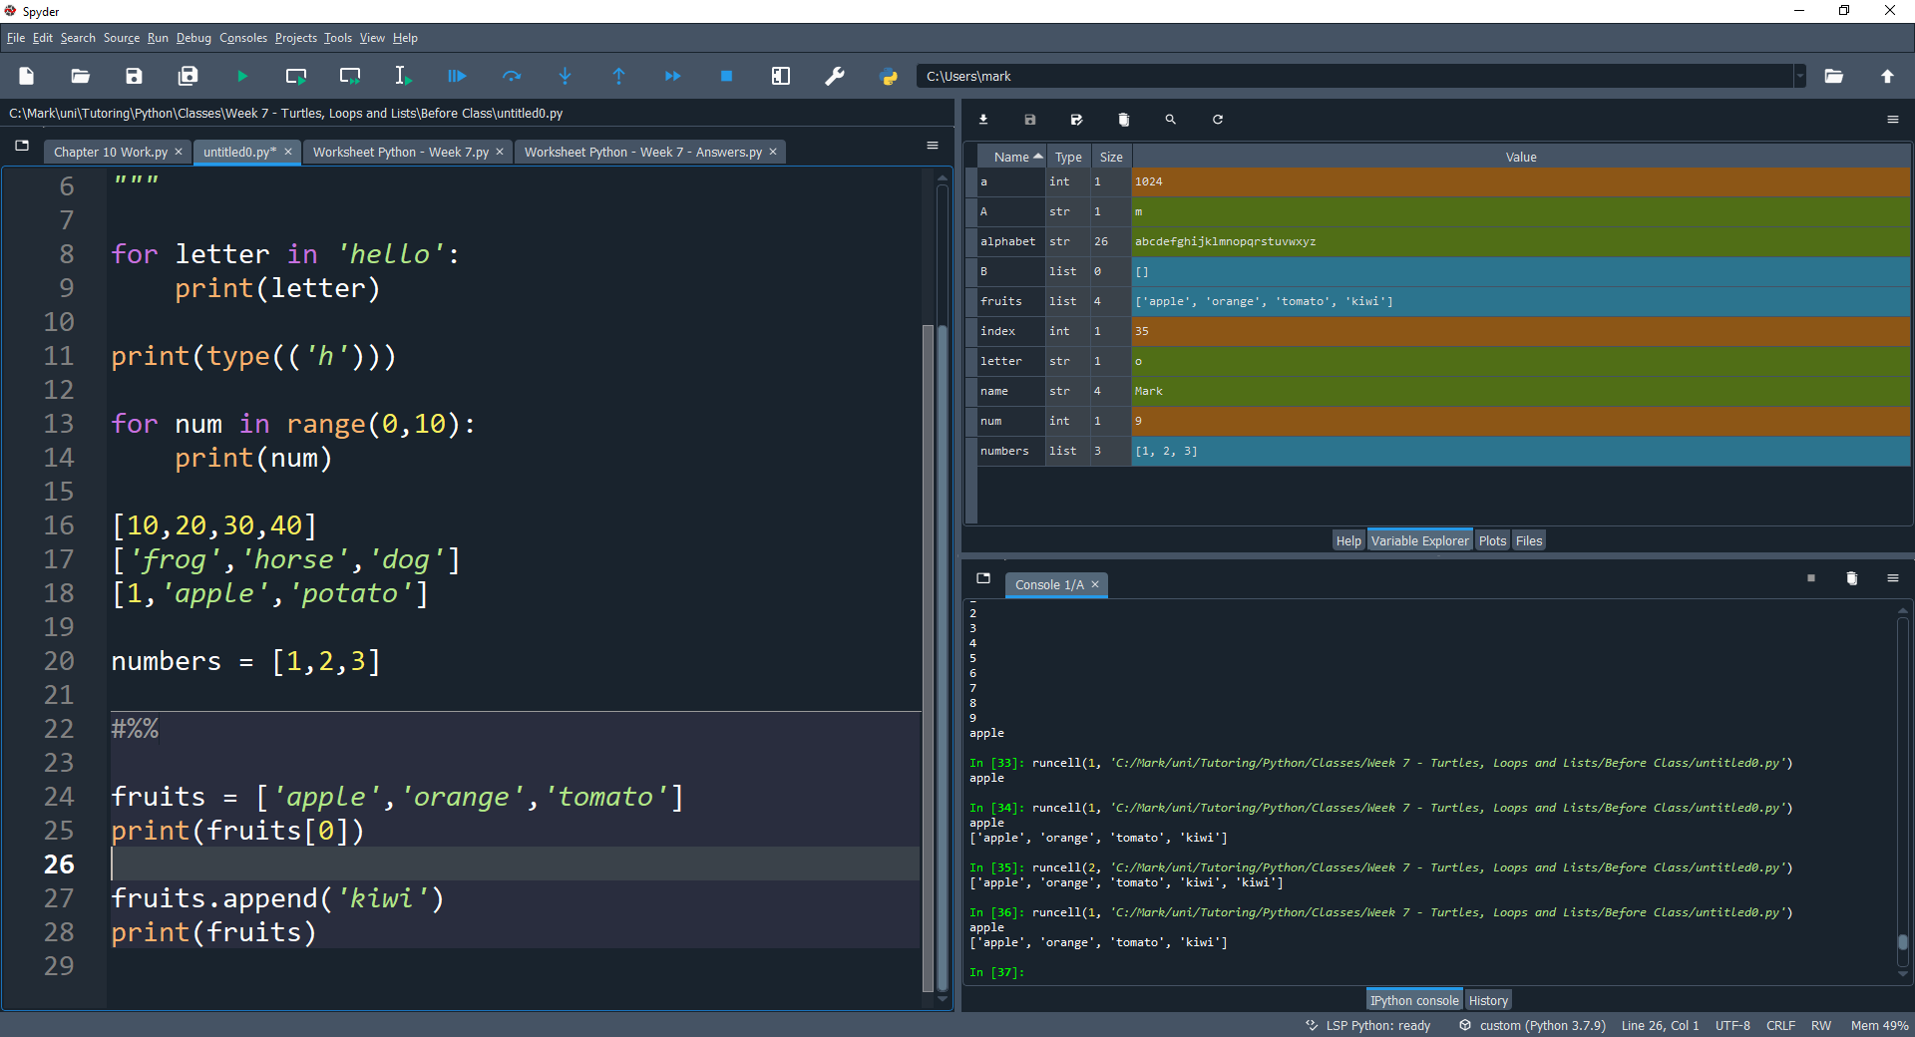
Lists accessing elements
We access elements of a list like so,
Where we start counting the Index from 0 in a list
0 -> ‘apple’
1 -> ‘orange’
2 -> ‘tomato’
To access the last element of the list, use [-1]. So fruits[-1] = tomato

Slide 10
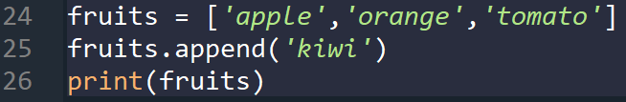
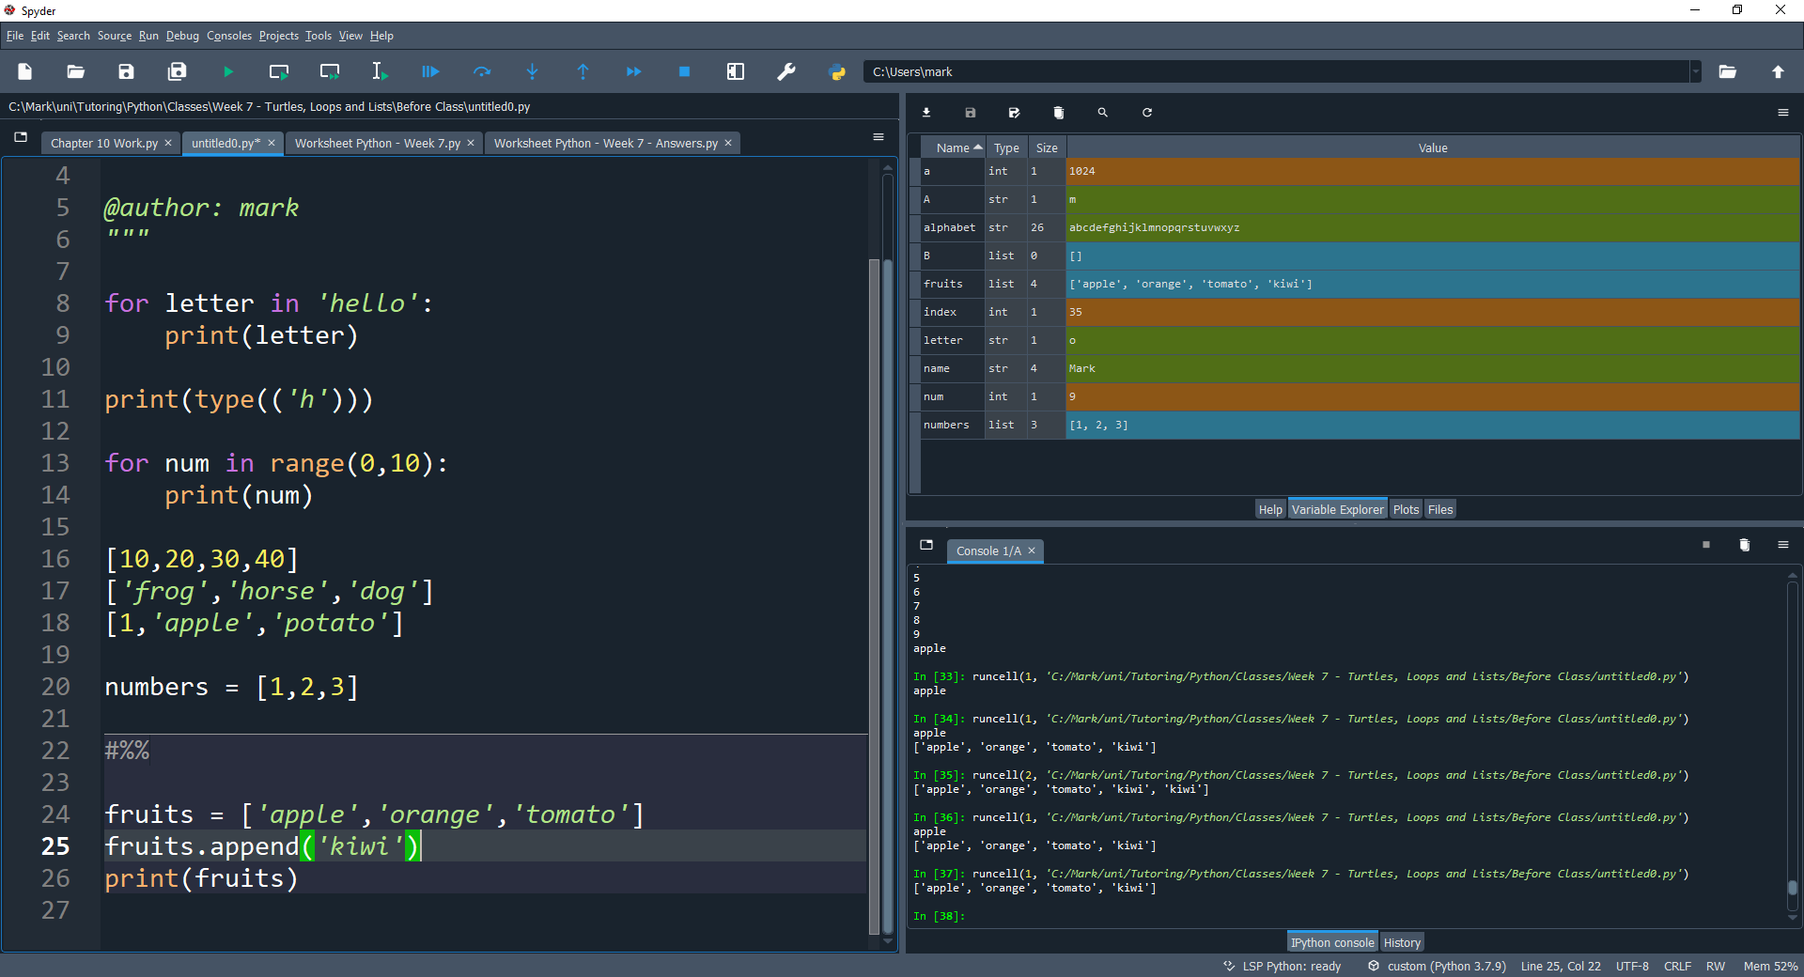
List methods -append
Methods are functions that we call with a dot, append adds a new element to the end of the list

Slide 11
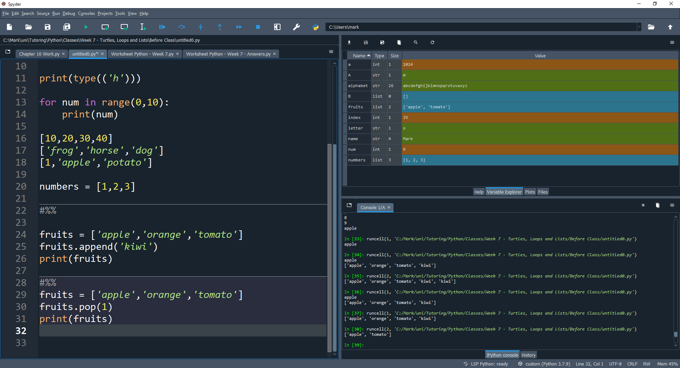
List methods - pop
Pop deletes an element from the list, of the given index

Slide 12
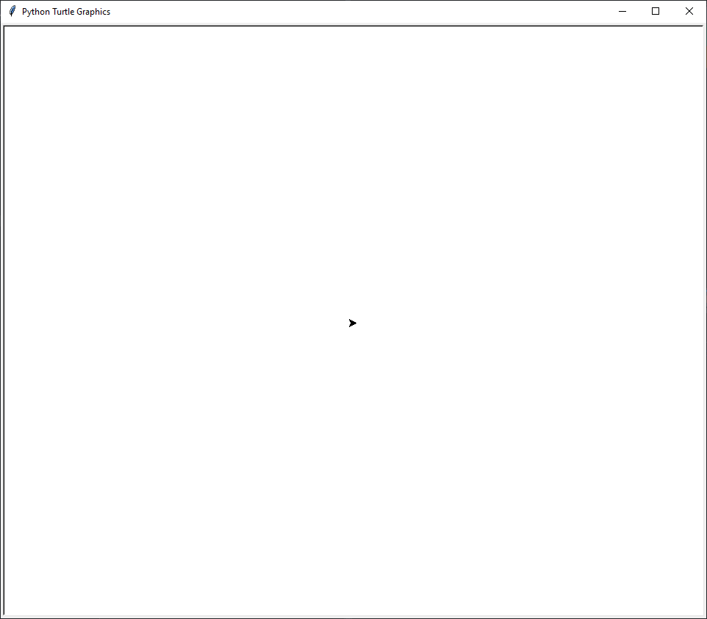
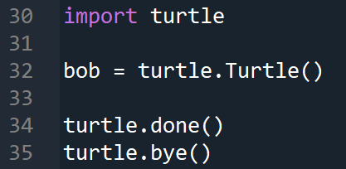
Turtle
Turtle is a module that allows us to create pictures using turtle graphics.

Slide 13
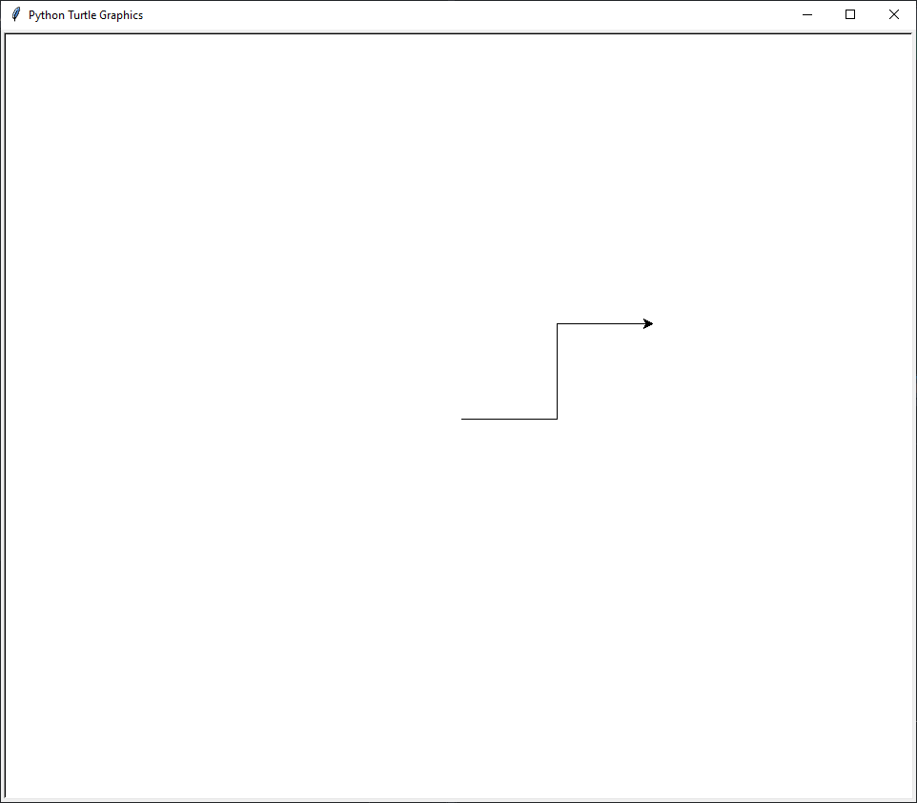
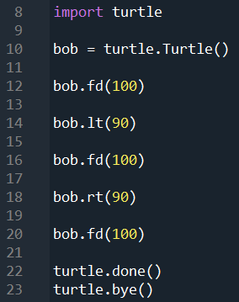
Turtle methods
Here are some useful methods,
Go forward 100 pixels
Turn left 90 degrees
Go forward 100 pixels
Turn right 90 degrees
Go forward 100 pixels

Slide 14
End of class
This week we have looked at:
What are Relational Operators
What are Conditional Operators
How do we use Conditional statements

